Slide 1
A Data-Driven Interface to Optimize Presentation of Water Quality Metrics
Shaun Fernando
Fernando Homeschool
January 2021

Slide 2
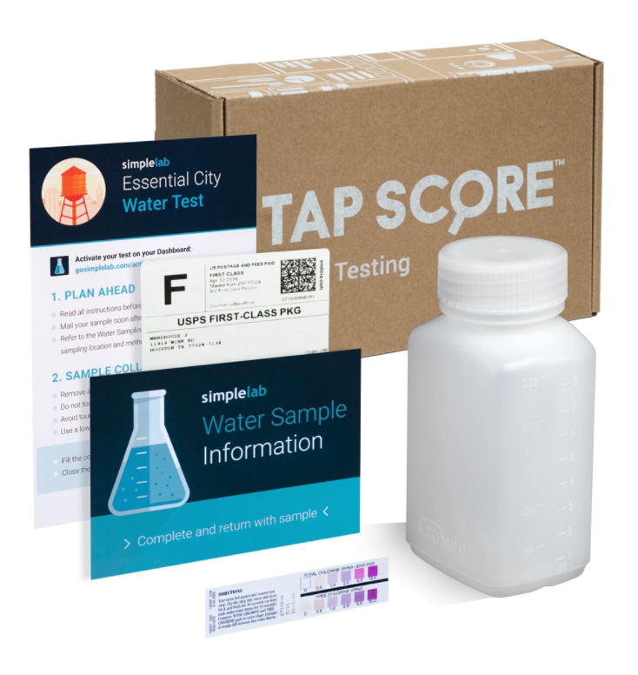
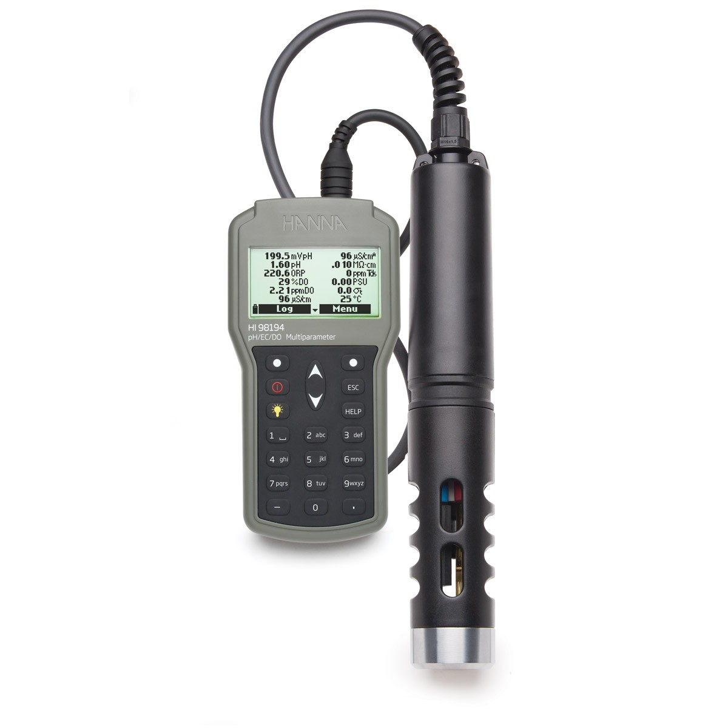
Background
Water Quality:
According to unesco.org, one in nine people worldwide uses drinking water from unimproved and unsafe sources
Many people want to know what is in their water without having to buy expensive meters and tools
There are not many interfaces that display water quality data in the market that are easy to use and read

Slide 3
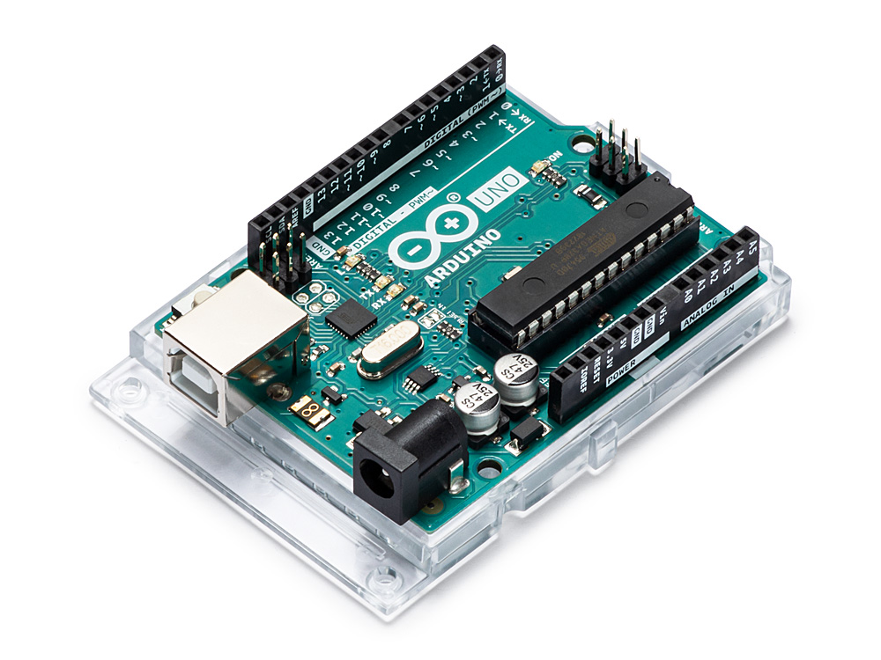
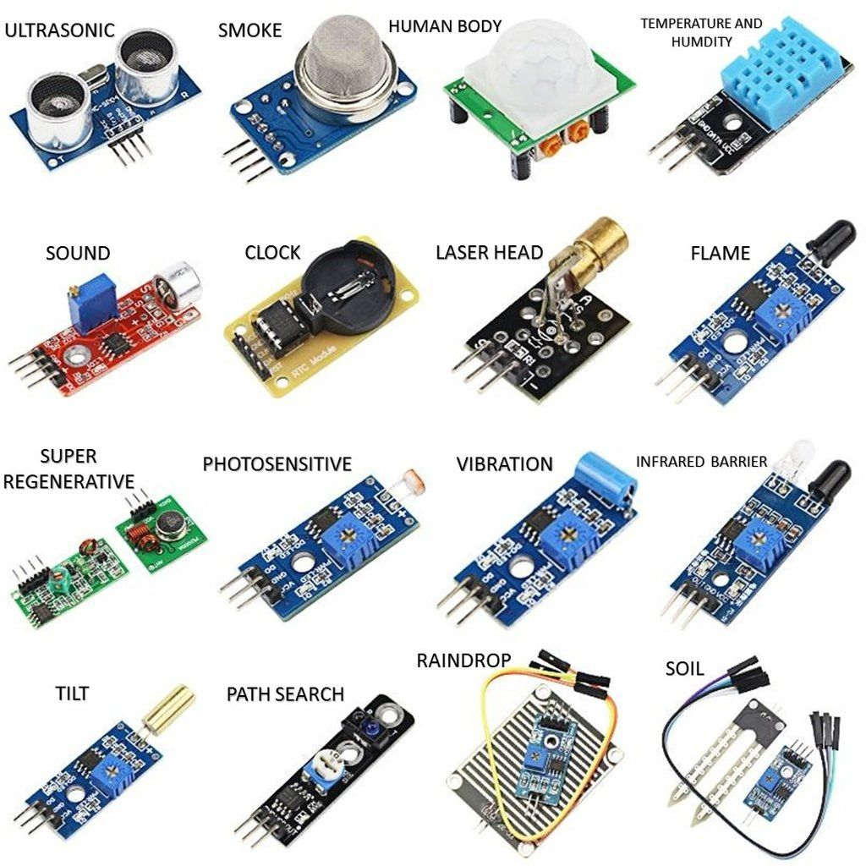
Background (cont.)
Arduino:
An easy to use microcontroller that uses the Arduino IDE software
There are many Arduino-compatible sensors on the market for any project

Slide 4
Problem Statement
Water quality plays an essential part in our world
Due to the lack of a low cost, easy to use system, many people don’t have access to water quality data

Slide 5
Design Objectives
Use Arduino to test water quality and gather water quality data
Prototype a user-friendly app to easily read and interpret data from the Arduino device

Slide 6
Materials
Arduino Uno
Arduino IDE Software
Breadboard
20x4 LCD Display
DS18B20 Temperature Sensor
pH Sensor
TDS Sensor
Turbidity Sensor
Data Logging Shield v1.0
SD Card
10k Ohm Potentiometer
220 Ohm Resistor
4.7k Ohm Resistor
Jumper Wires
Soldering Iron Kit

Slide 7
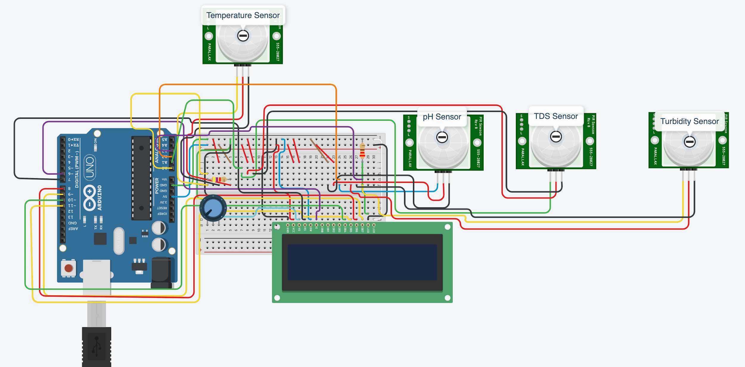
Circuit Diagram

Slide 8
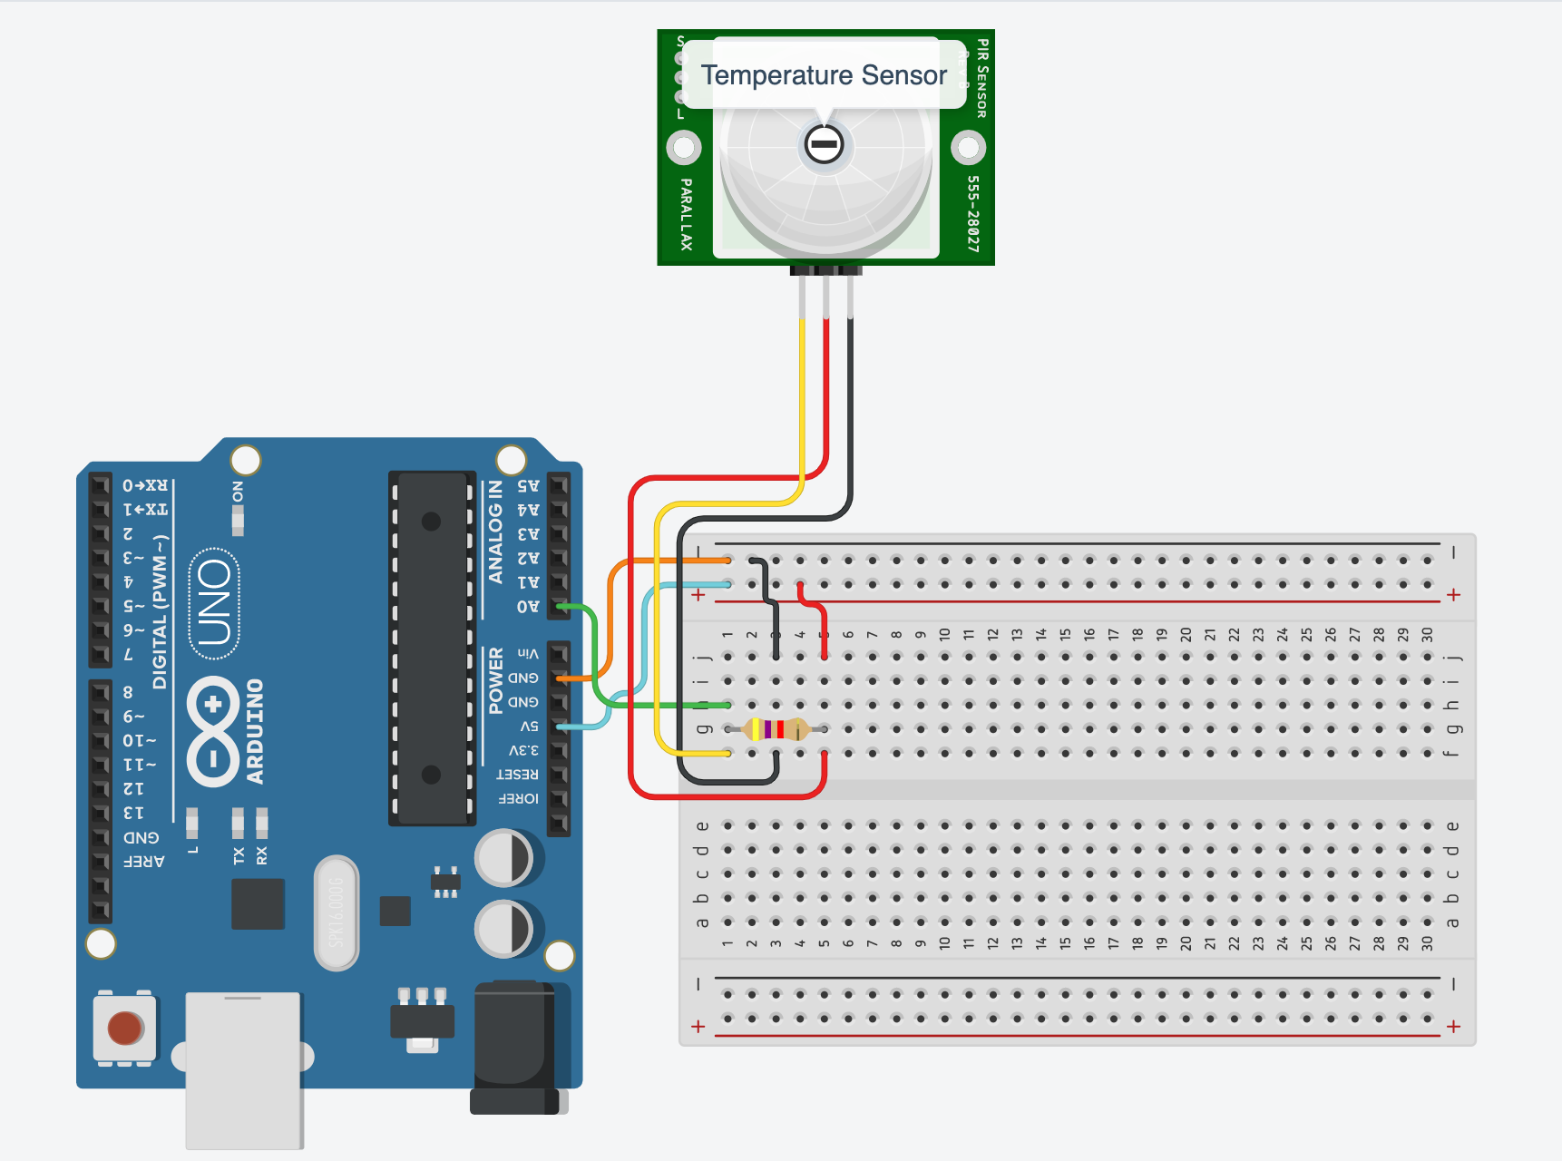
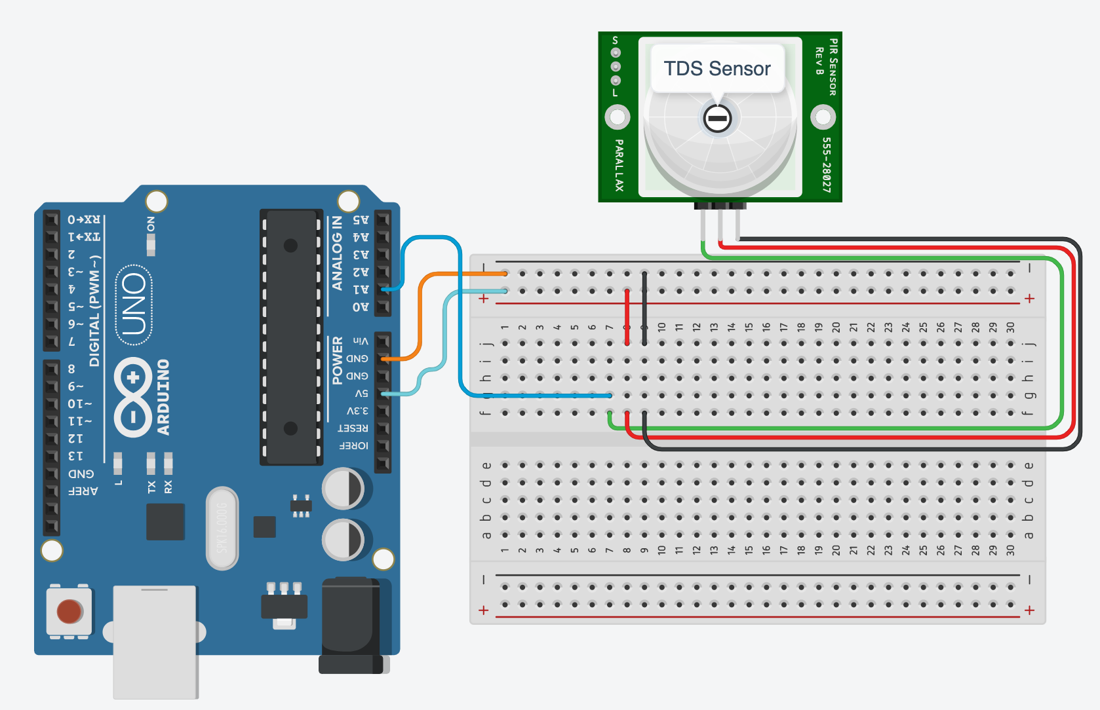
Circuit Diagram Breakdown
Temperature Sensor Circuit
TDS Sensor Circuit

Slide 9
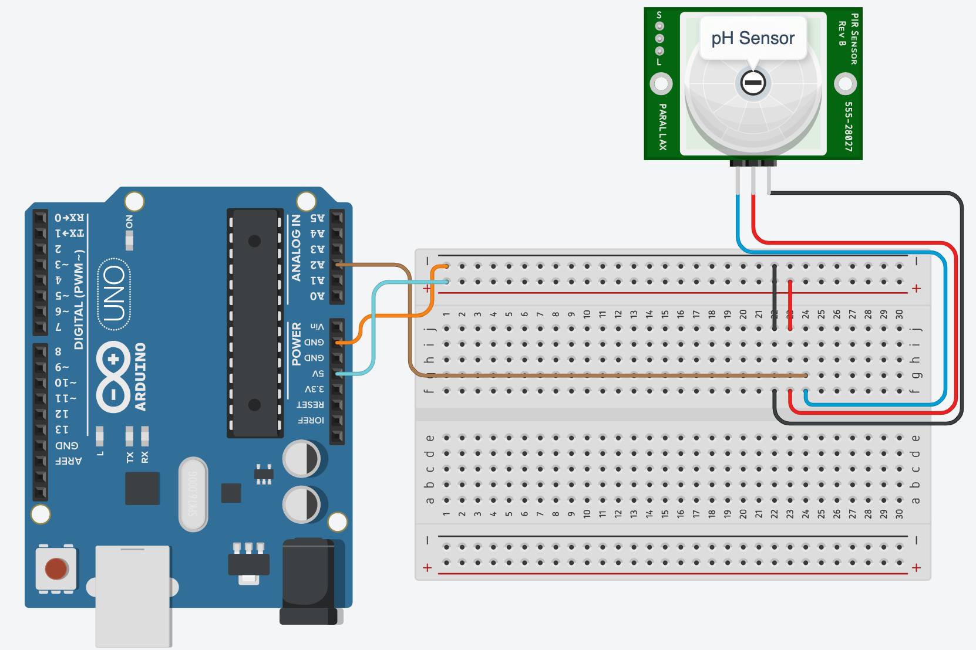
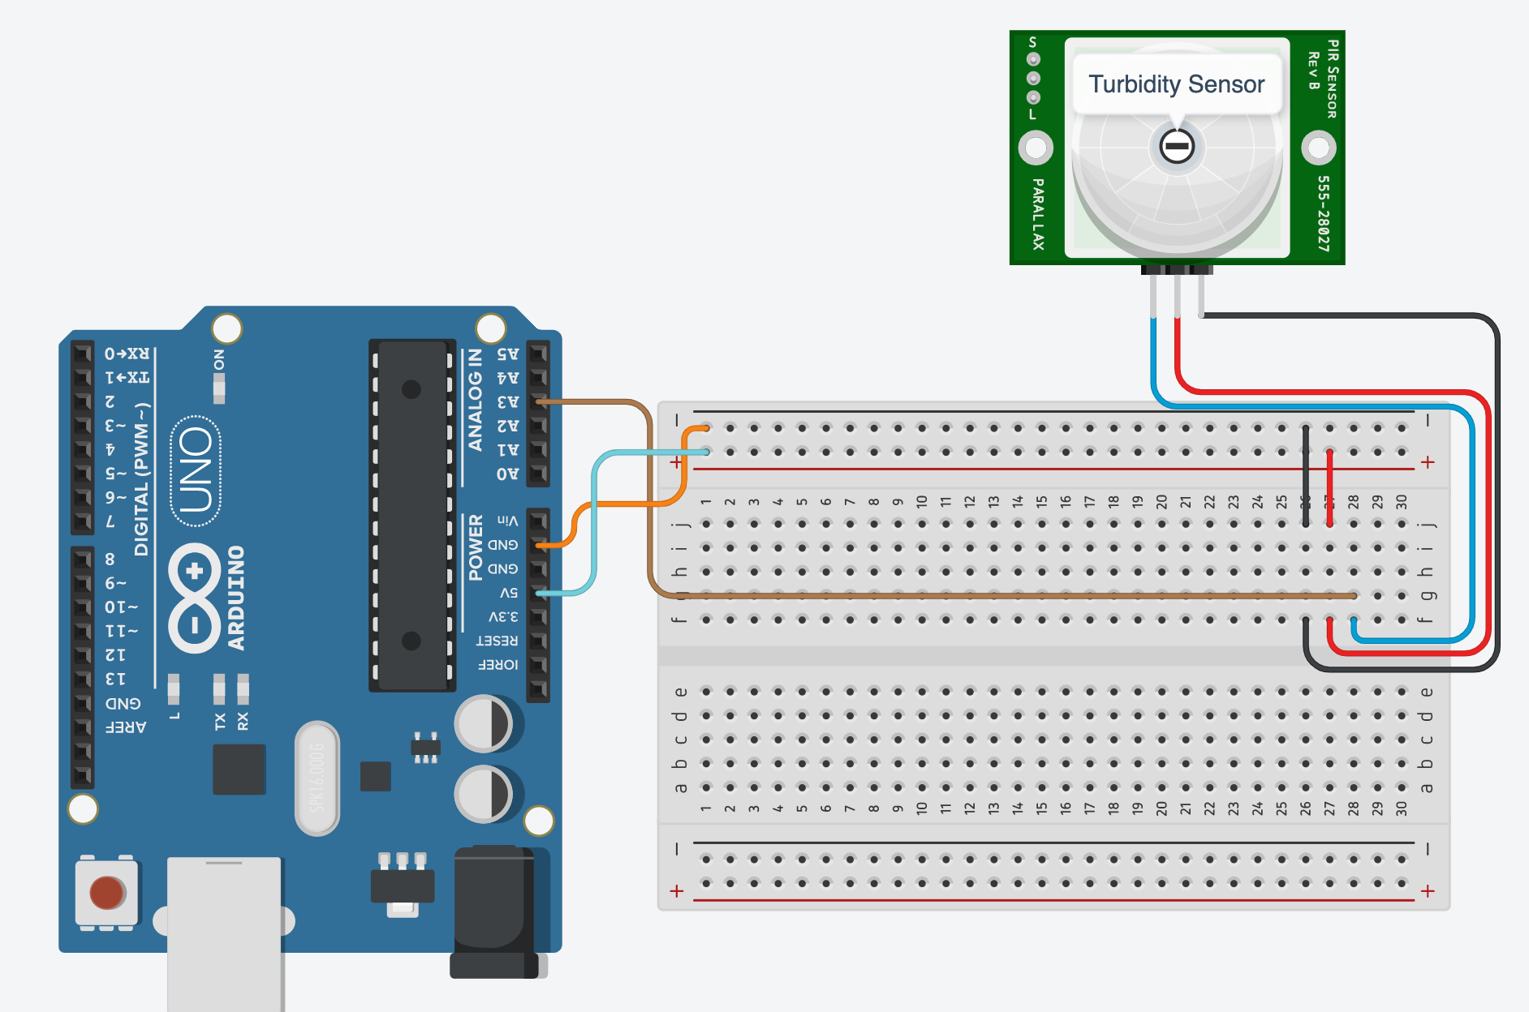
Circuit Diagram Breakdown (cont.)
pH Sensor Circuit
Turbidity Sensor Circuit

Slide 10
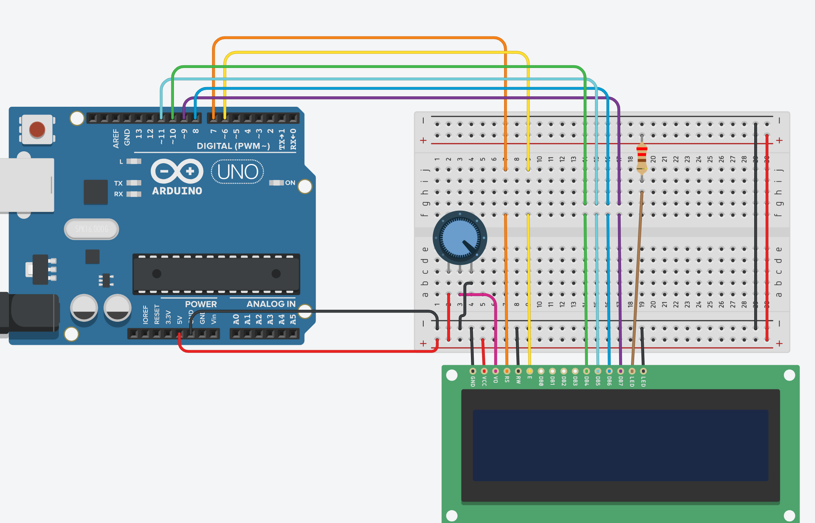
Circuit Diagram Breakdown (cont.)
LCD Display and Potentiometer Circuit

Slide 11
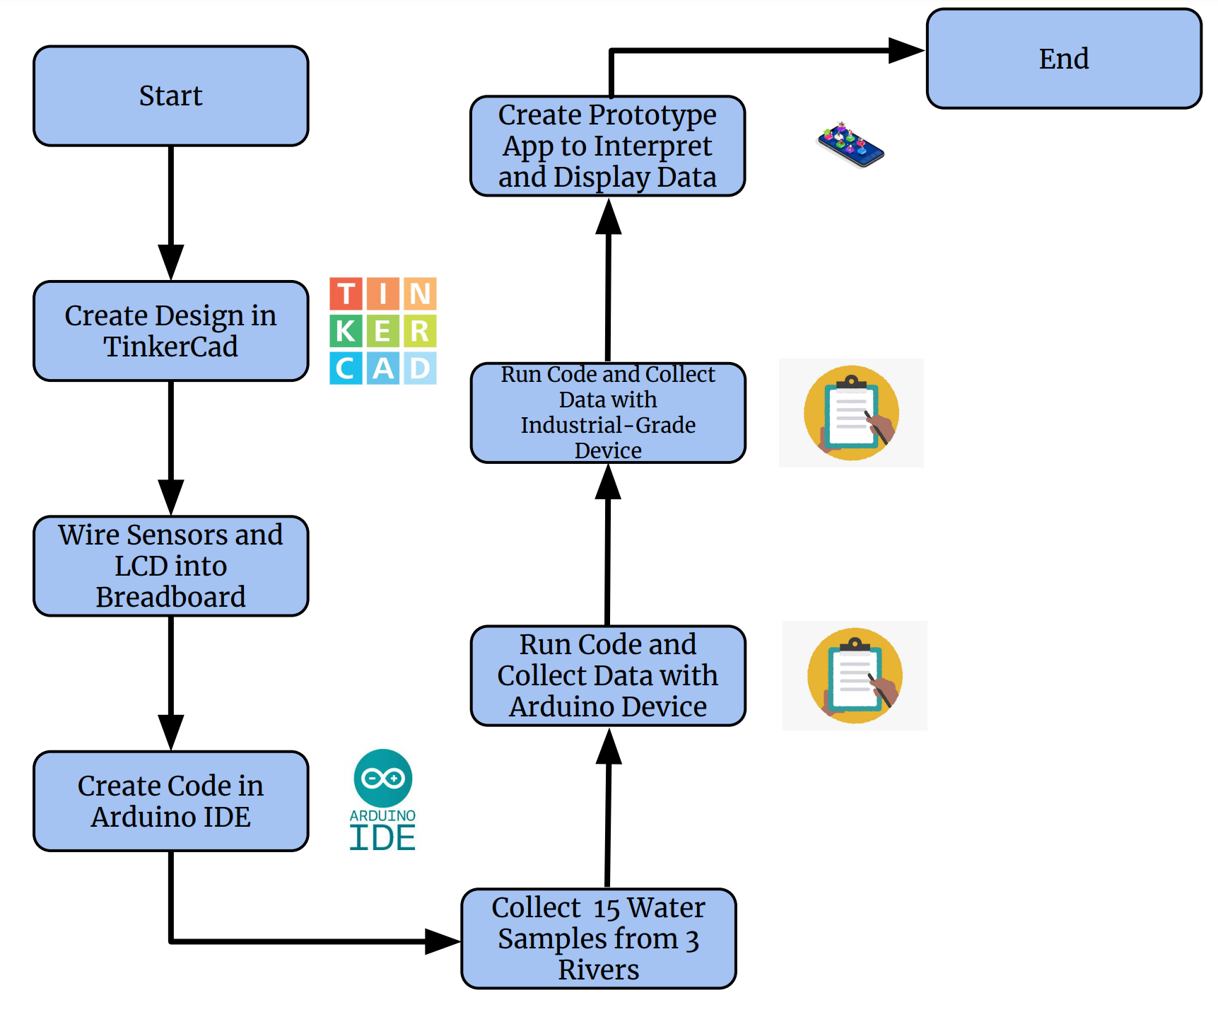
Procedure

Slide 12
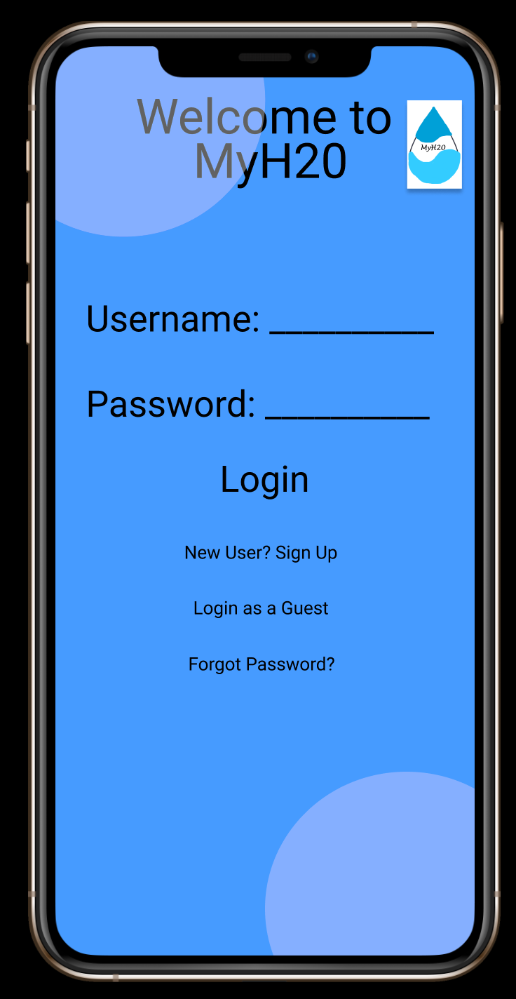
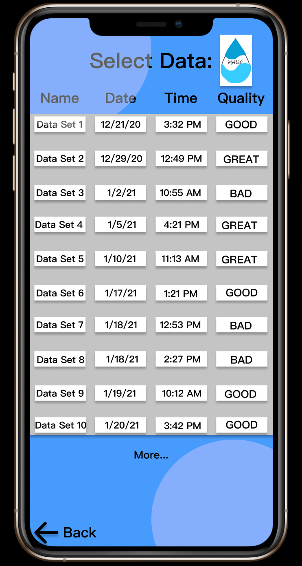
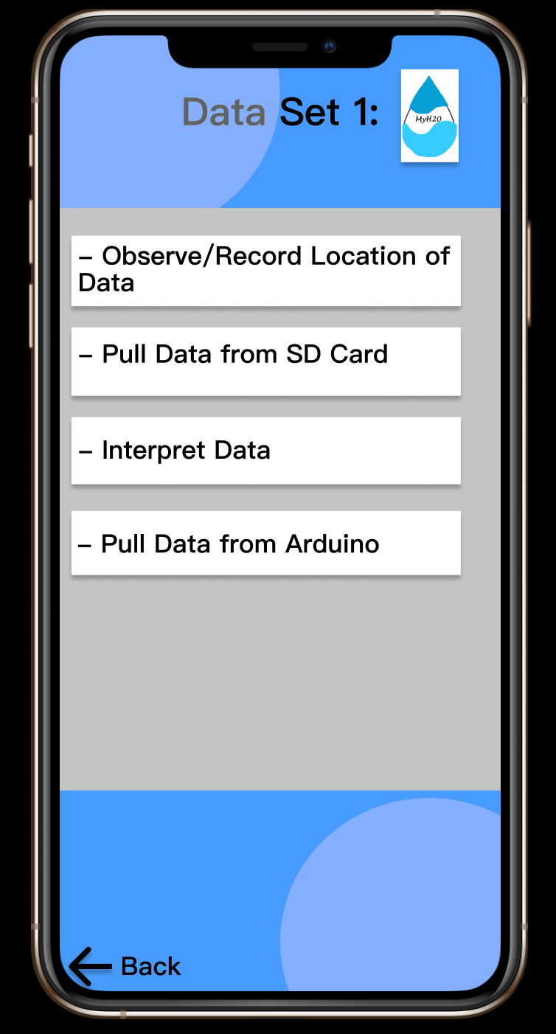
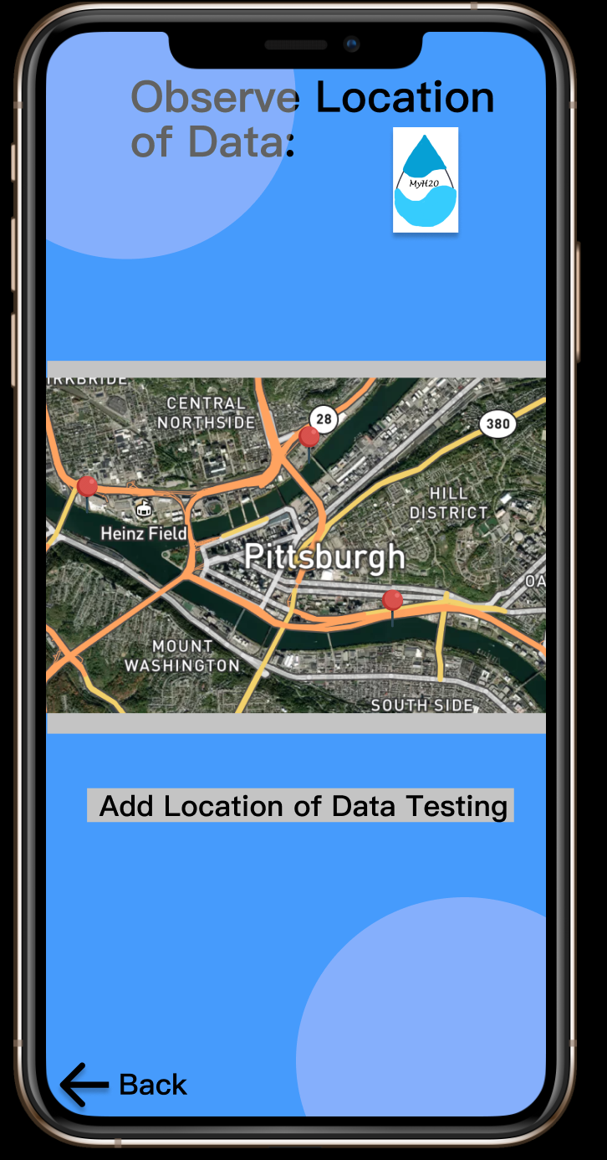
Results (1 Instance)

Slide 13
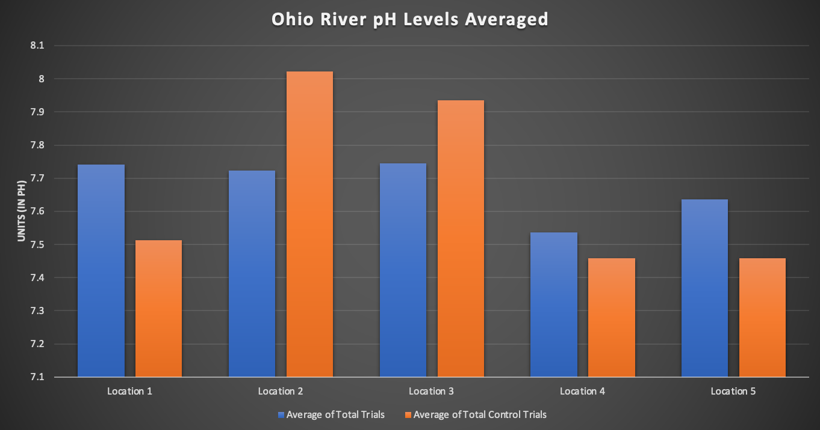
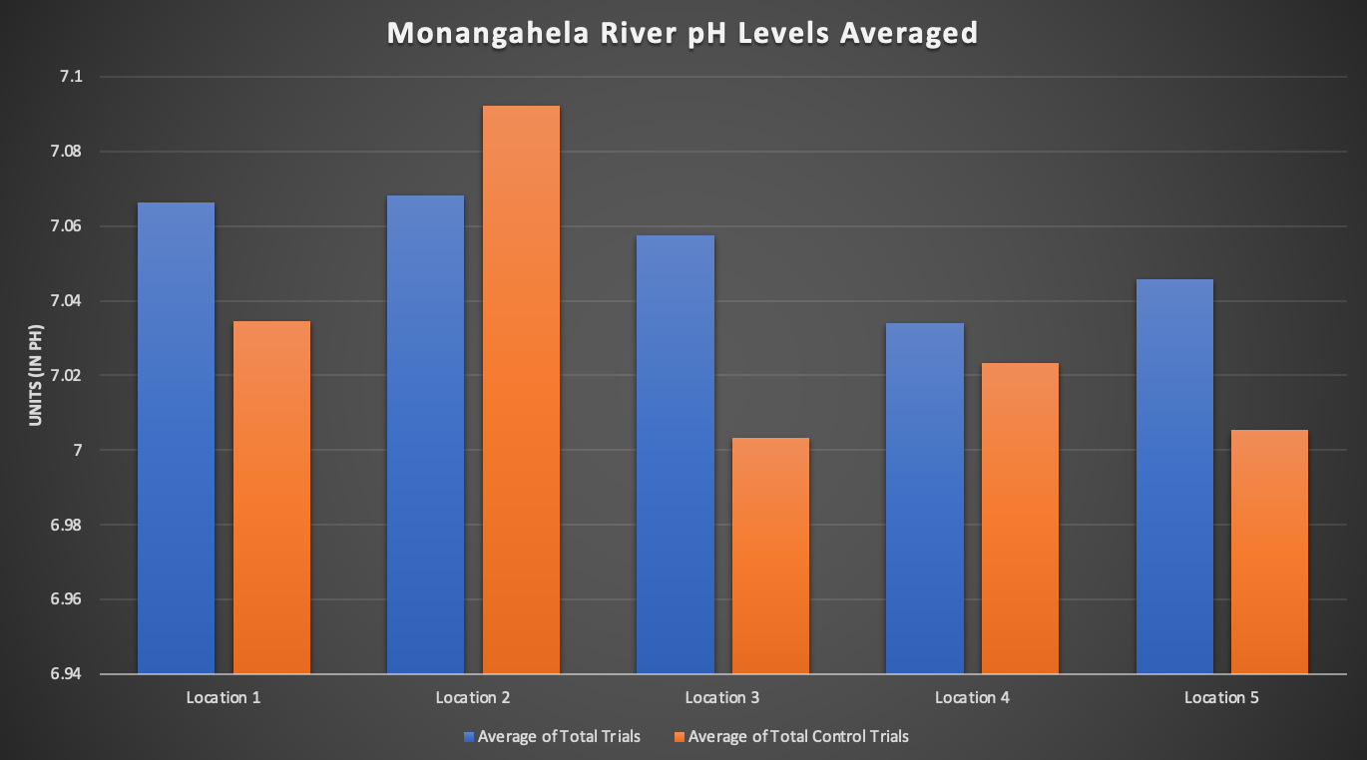
Results for pH Levels

Slide 14
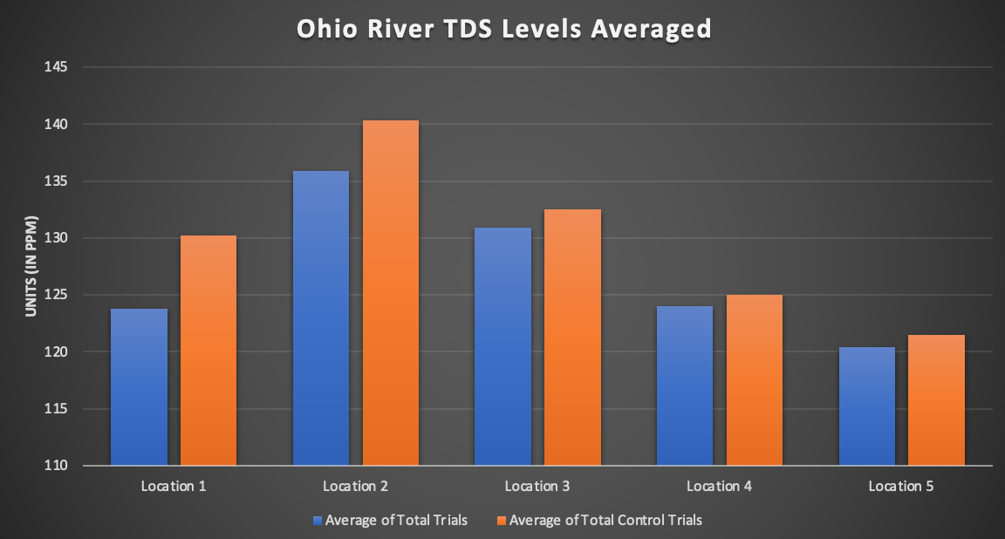
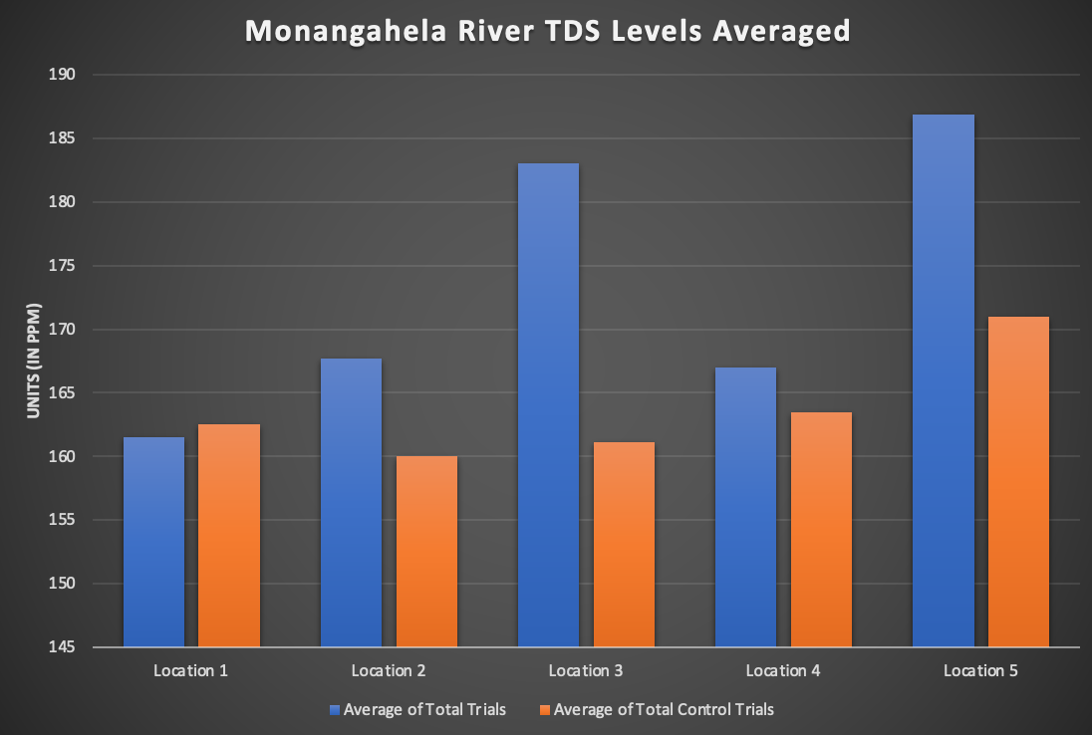
Results for TDS Levels

Slide 15
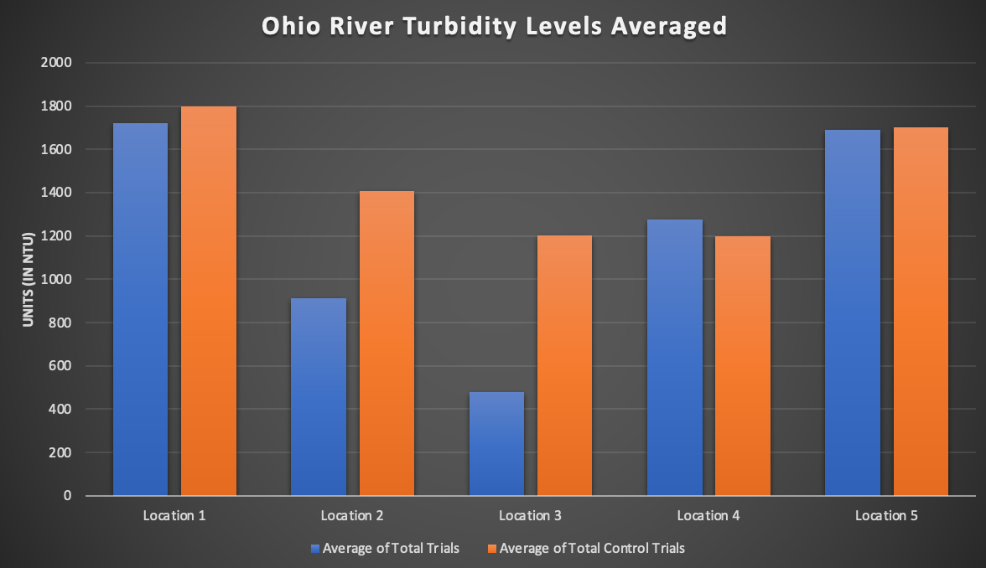
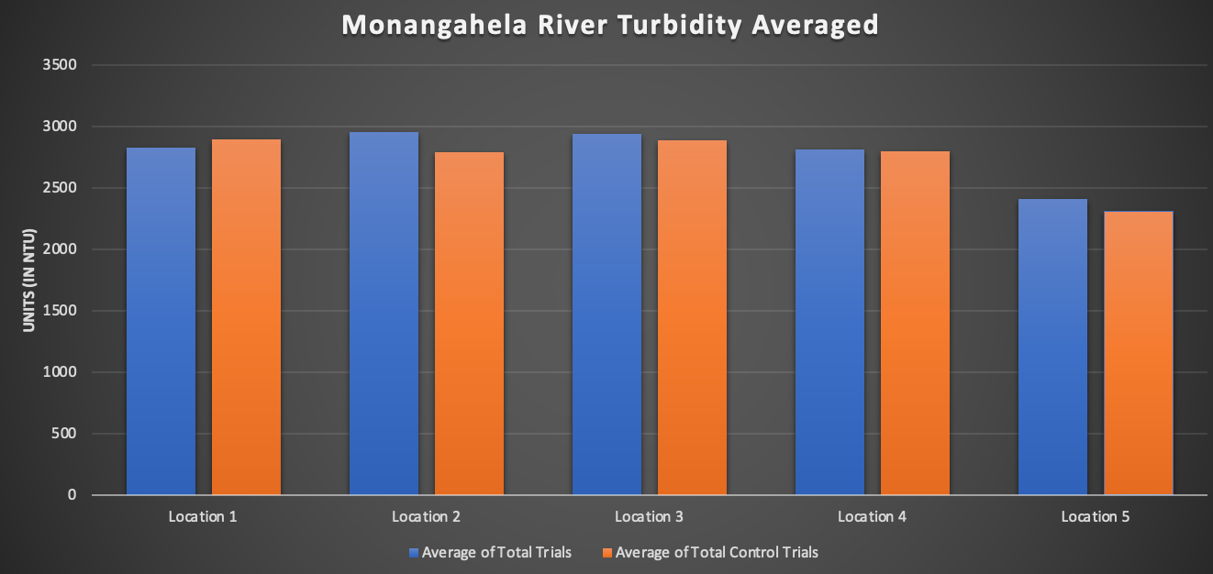
Results for Turbidity Levels

Slide 16
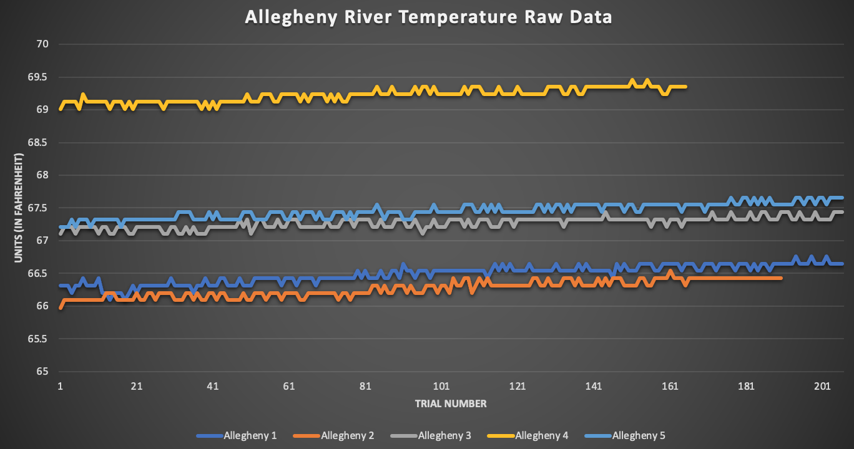
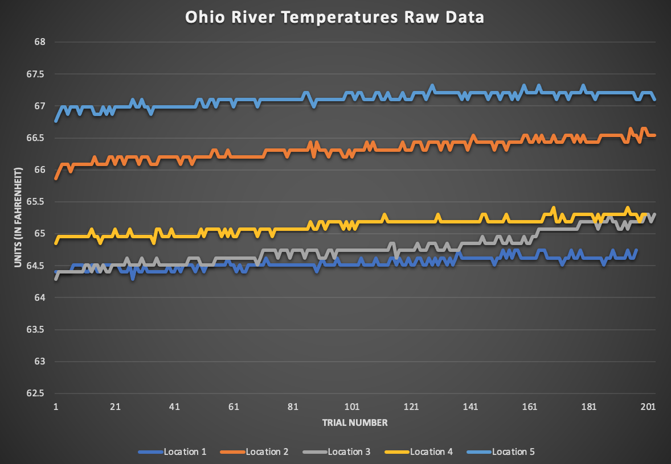
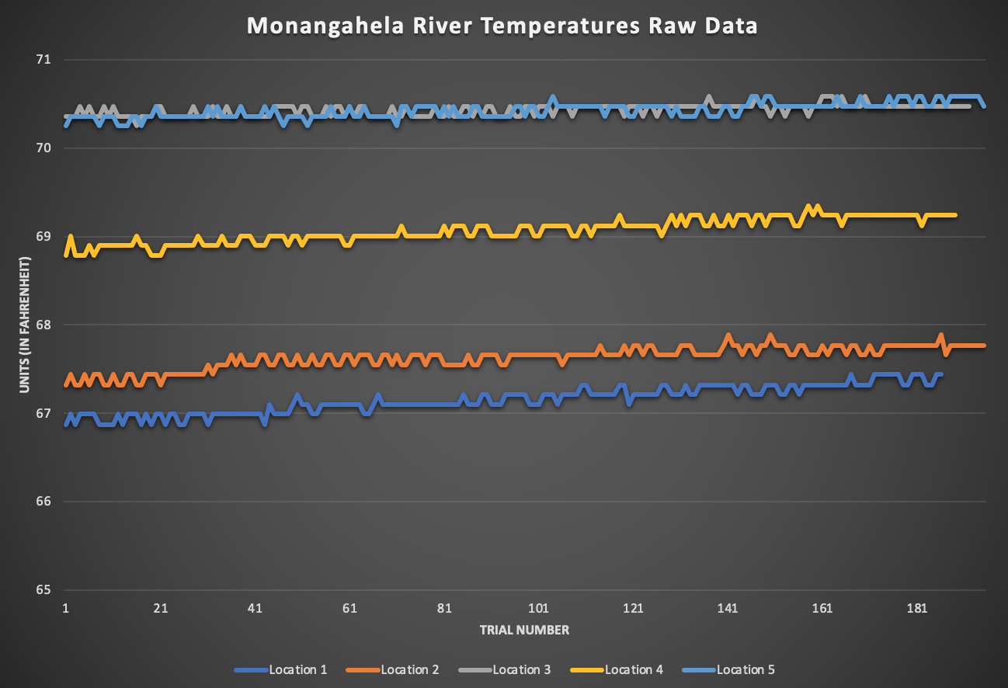
Results for Temperature Levels

Slide 17
Conclusion
The Arduino device collected water quality data efficiently and was easy to use
The website created with Figma displayed the data neatly and was easy to read and use

Slide 18
Limitations
Device needed to be plugged into the computer to run
Sensors needed to be calibrated once in a while
Device is not very portable
Code needed to be compiled and uploaded if device is not plugged into computer

Slide 19
Extensions
Make device wireless
Use a Bluetooth module to be able to immediately send data from the device to website
Make the device more portable by using a smaller microcontroller (Arduino Nano, Arduino Micro)
Include more parameters for water quality testing (Dissolved oxygen, electrical conductivity)
Use an I²C Module for the LCD to decrease the amount of wires

Slide 20
Acknowledgements
My mom (spoonser)

Slide 21
Rationale
Water quality is an area that impacts everyone on this planet
Arduino can be used for projects like collecting and storing data
Figma is a site that can create wire-frames which can act as websites or apps
How can I use Arduino to create a device to collect and store water quality data and create a website using Figma to interpret this data in a user-friendly way?

Slide 22
Procedure
Device was sketched out in TinkerCad for planning
Header pins were soldered onto LCD to fit into breadboard
Temperature (with 4.7k ohm resistor), TDS, pH, and Turbidity sensors were wired into Arduino and breadboard
LCD(with 220 ohm resistor) and bluetooth module were wired into breadboard and Arduino
Code was written in Arduino IDE
5 samples from different spots were taken from each of five rivers and creeks, and data was recorded
User-friendly mock-interface was made to show and interpret data

Slide 23
Hypothesis
Null Hypothesis: The Arduino-based device is not accurate and the app created using Figma does not display the data in a user-friendly way
Alternative Hypothesis: The Arduino-based device is accurate and the app created using Figma displays the data in a user-friendly way

Slide 24
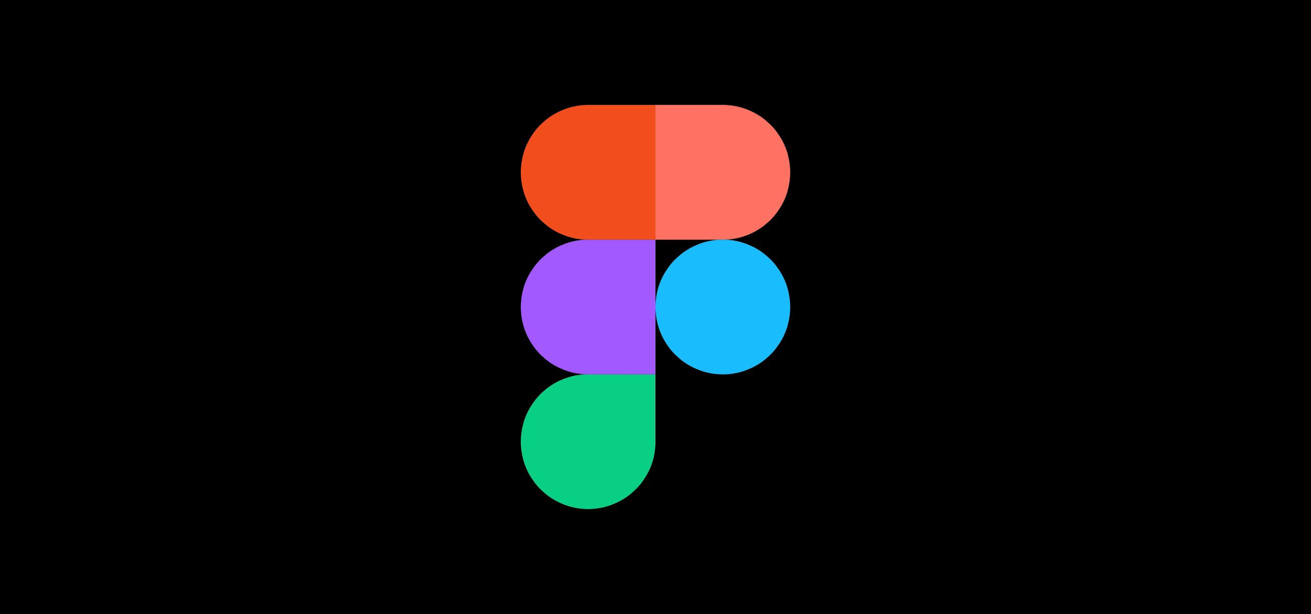
Background (cont.)
Figma:
Figma is a web-based prototyping tool that allows users to create any graphics that they desire
Figma has the ability to create representations of apps and websites using wireframes

Slide 25
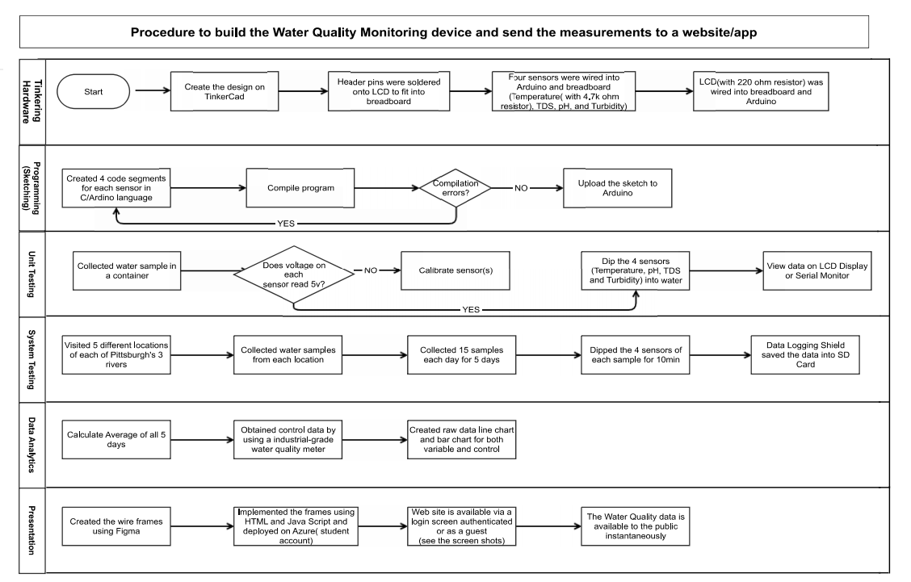
Procedure

Slide 26

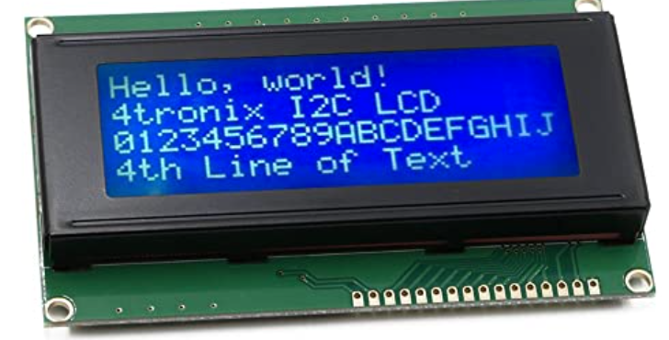
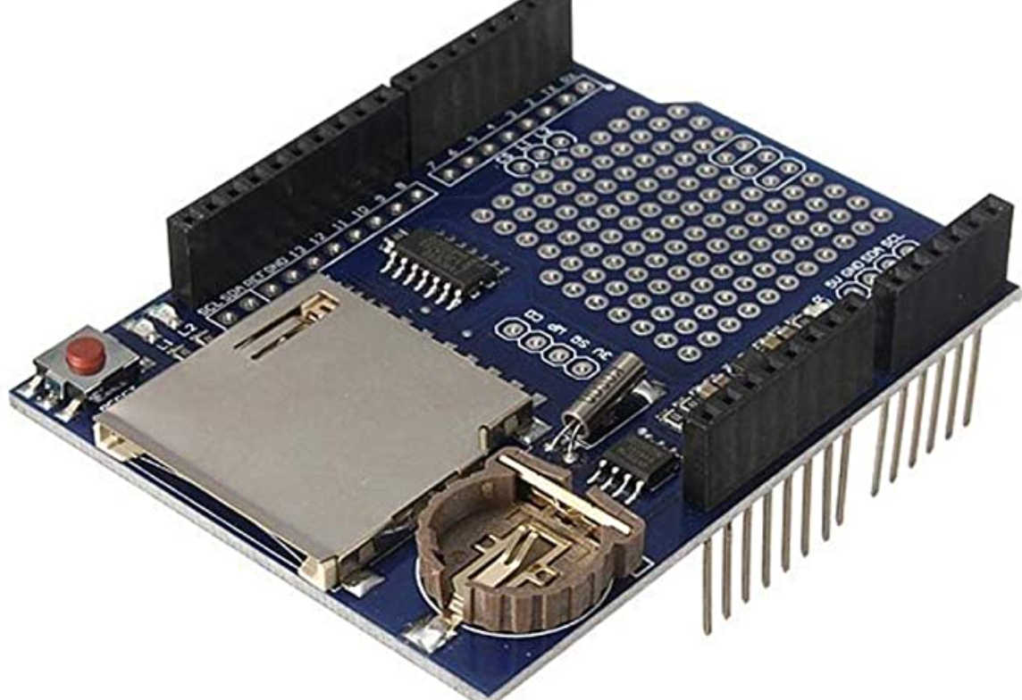

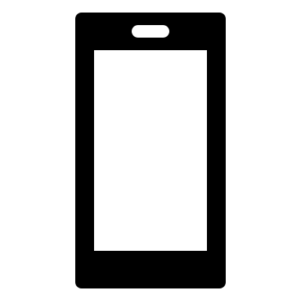

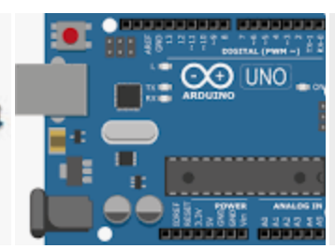

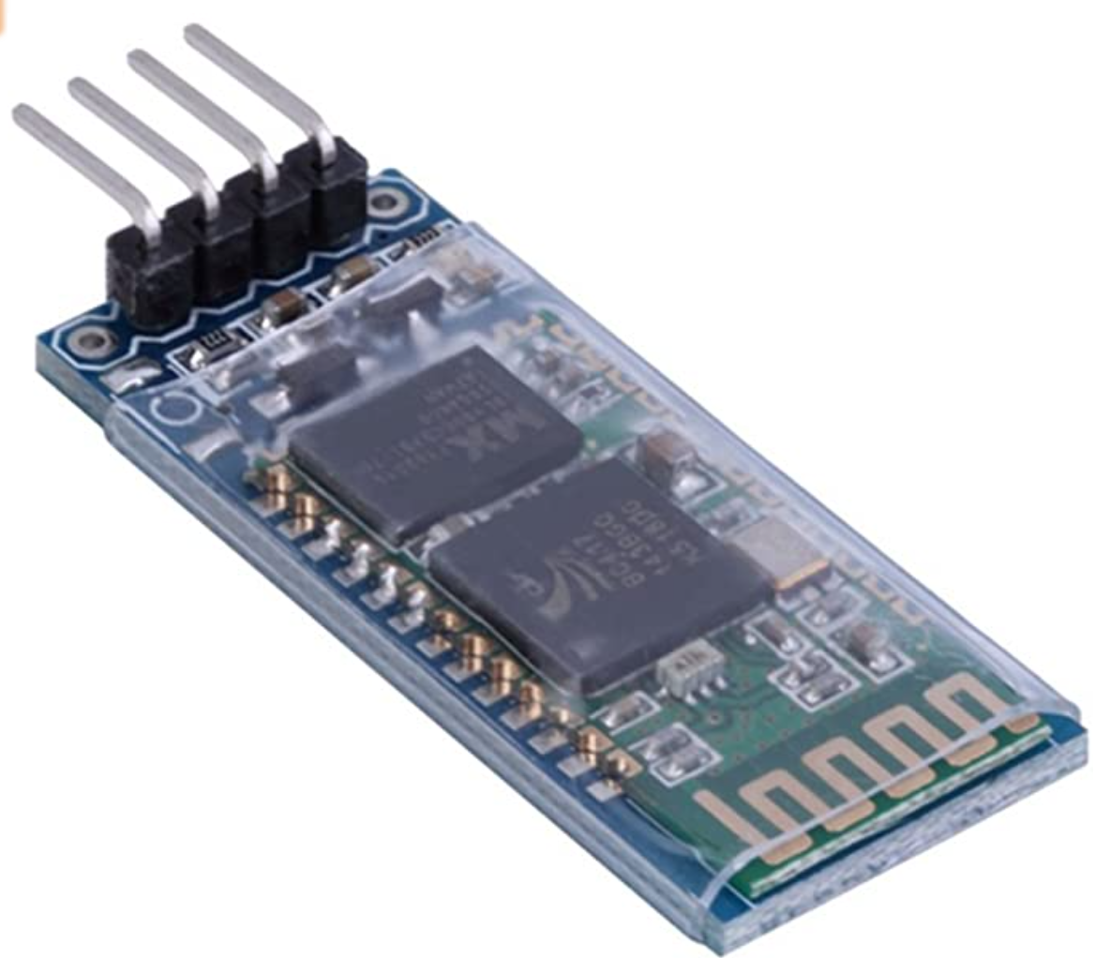
Component Diagram
User
base
Water Sources
Component based tier to Collect Data, Store and Transmit
Presentation
Tier

